Slide 1
Phishing Freakonomics (aka “Picking Winners”)
Russell Butturini
Senior Information Security Architect, Top 20 CPA Firm
Defcon 27 Packet Hacking Village

Slide 2
-Senior security architect and head of all things IT security along with my governance and compliance dictatress at a top 20 CPA/financial services firm.
-@tcstoolhax0r on Twitter
-Presenter at various Bsides, Derbycon, PHV, etc.
-Occasionally releases poorly written Python code that does cool things.
-Everything said in this talk is mine and doesn’t represent the views of my employer current or past employers.
(Not a picture of me)
Notes:
-Tell the property brothers story!

Slide 3
Why give this talk?
-”Phishing always works”
-”Users are stupid”
-”People are the weakest link”
-”It only takes one”

Slide 4
The Story
-No previous training and awareness program
-Never done phish testing
-Unstructured reporting for email threats, lack of centralized security awareness resources for end users

Slide 5
The Story

Slide 6
The story

Slide 7
A New Approach
-Decide what the goal of testing is
-Figure out why people are “vulnerable”; how do we patch them?
-USE THE DATA

Slide 8
The goal of a phishing exercise should never be to fail as many users as possible, it should be to educate as many users as possible.

Slide 9
Warning: Not a Data Scientist

Slide 10
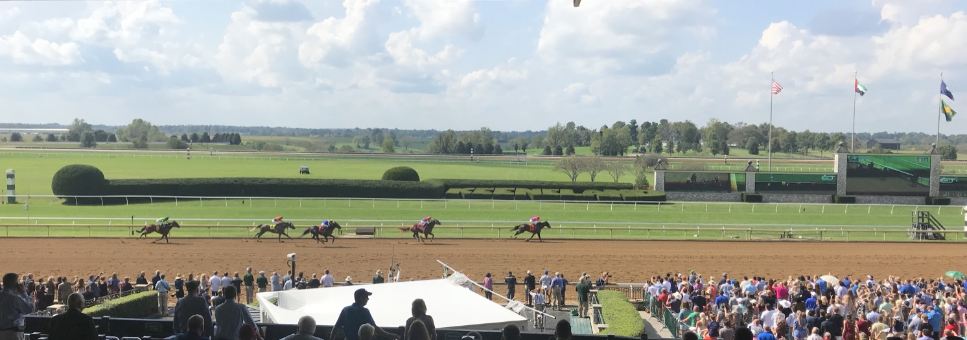
I do this instead…

Slide 11
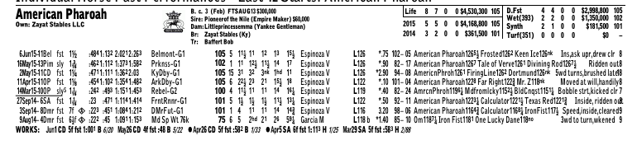

Slide 13
Key Questions
-Can we use various data points (“angles”) to predict which users have a higher likelihood of falling victim to a phishing attack than others?
-Are there seemingly unrelated factors that should be examined to find patterns of phishing failures?
Notes:
Good guys and bad guys can use this data!!!!

Slide 14
Notes:
Good guys and bad guys can use this data!!!!

Slide 15
Data Points
-10 years of phishing test results and training data from 3 different large environments.
-Phishing related security incidents
-HR data
-Survey results
-Miscellaneous data
-Sample size of ~3,200 “fails” (not all events had the same amount of data)
-Started with ~60 working theories on where correlations would lie

Slide 16
Elasticsearch/Kibana
-FREE
-Allowed for analyzing dissimilar events with different data points quickly.
-Simple to populate using Python

Slide 18
-Subdividing the 10+ group further, 40% of the failures came from 22+ years of experience.
-New grads explained spikes….Timing changes risk!
Action: Have office managers work with “elderly” colleagues and new hires to ensure they not only complete but understand security awareness. Add additional content to new hire training.

Slide 19
Survey
-Did you previous employer conduct security awareness training or phishing tests?
-Do you feel internal mass communications (i.e. emails from IT, HR, benefits) are easy to identify as legitimate?

Slide 20
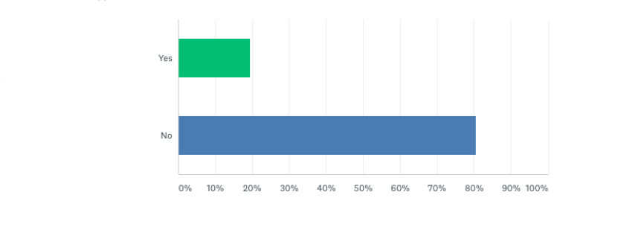
Did your previous employer conduct security awareness training or phishing tests?

Slide 21
-Not enough employers are investing time in training people!!!
-One round of training may not be enough.
Action: Continue to aggregate data and track participation in training programs to improved results at an individual level.

Slide 22
Failures by Category
Category | Failure Percentage
Human Resources | 19.8%
IT | 13.2%
Online Services (email notifications, file sharing, etc.) | 10.9%
Coupons | 7.1%
Business and Financial Services | 6.3%

Slide 23
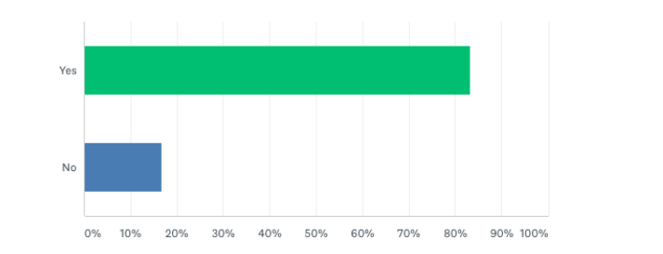
Do you feel internal mass communications (i.e. emails from IT, HR, benefits) are easy to identify as legitimate?

Slide 24
-Huge disconnect between the employees and corporate communications.
(i.e. They don’t know what they don’t know)
Action: Work with corporate marketing to develop a standardized look and feel for mass communications all departments can use.

Slide 25
Timing

Slide 27
-Completing the training early doesn’t mean it was effective.
-People who wait for the right time to do awareness training and maximize its value are the least risky.
Action: Communicate better with staff around training reminders. If a busy time is coming up, encourage staff to complete beforehand.

Slide 29
-Training effects last about 60 days!
-Less frequent reinforcement = More fail.
Action: Provide frequent reinforcement. Evaluate doing multiple small trainings throughout the year vs. one large annual training.

Slide 30
Environmental Factors/Weird Stuff

Slide 33
A few more thoughts…
-Make contact human and personal
-Avoid shaming at all costs
-Contests don’t work
-Always accentuate the positive

Slide 34
Results
-Haven’t implemented everything yet, but still saw a nearly 2% improvement from the previous “bad” test to the next test.
-Not enough data accrued yet to decide if this is coincidental or a hard result.
-Informal, anecdotal feedback has been VERY positive!

Slide 35
That’s it!
-Thanks to PHV for having me and thanks to all of you!
-@tcstoolhax0r on Twitter
-Slides will be up at github.com/tcstool later
-Questions?

